Slide 1

boost::out_ptr – a scalable output pointer abstraction for smart pointers
Implementing C++20’s P1132 – Targeting Boost 1.71
ThePhD
phdofthehouse@gmail.com; @thephantomderp
https://thephd.github.io/vendor/future_cxx/papers/d1132.html
https://github.com/ThePhD/out_ptr

Slide 2
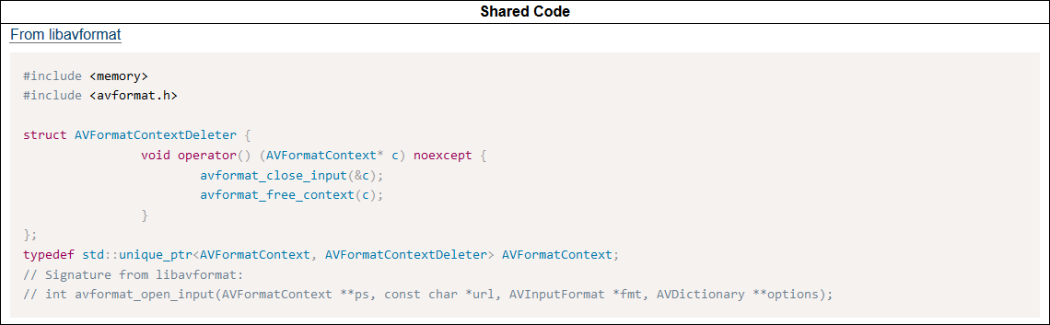
Preliminary Code

Slide 3
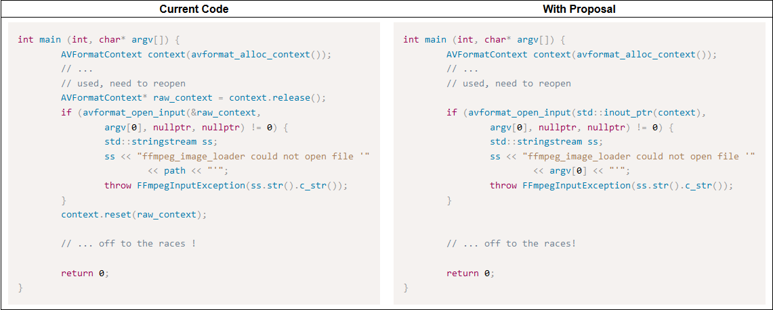
Before/After

Slide 4
Motivation I – Standardize Existing Practice
The Most Existing-iest Practice there has ever Been
Microsoft: CComPtr, circa before I knew what a computer was
Fortune 100 Companies, small hobby developers, game studios, etc. have this abstraction (including VMWare, co-authors)
std::retain_ptr (http://wg21.link/p0468) was going to overload operator& - this paper solves their problem
Microsoft: got a better idea and have WRL::ComPtrRef instead of overloading unary & which behaves exactly like std::out_ptr/std::inout_ptr

Slide 5
Motivation II
Remove the destructive urge people have to overload unary operator& on smart pointers
Let them not fall as Microsoft has in ye olden days: CComPtr
https://groups.google.com/a/isocpp.org/forum/#!topic/std-proposals/8MQhnL9rXBI
Remove the only reason anyone wants to overload unary operator&
Pave the way for std::addressof to become obsolete
Prevent defensive programming by library programmers

Slide 6
Design
namespace std { template <class Pointer, class Smart, class... Args> out_ptr_t<Smart, Pointer, Args...> out_ptr(Smart& s, Args&&... args) noexcept; template <class Smart, class... Args> out_ptr_t<Smart, POINTER_OF(Smart), Args...> out_ptr(Smart& s, Args&&... args) noexcept; template <class Pointer, class Smart, class... Args> inout_ptr_t<Smart, Pointer, Args...> inout_ptr(Smart& s, Args&&... args) noexcept; template <class Smart, class... Args> inout_ptr_t<Smart, POINTER_OF(Smart), Args...> inout_ptr(Smart& s, Args&&... args) noexcept; }

Slide 7
Design: Well-Defined as Argument
std::unique_ptr<int, resource_deleter> resource(nullptr); error_num err = c_api_create_handle(24, std::out_ptr(resource)); if (err == C_API_ERROR_CONDITION) { // handle errors } // resource.get() the out-value from the C API function

Slide 8
Design: shared_ptr safety
When used with std::shared_ptr, it requires that additional arguments are passed so it can reset the deleter too:
std::shared_ptr<int> resource(nullptr); error_num err = c_api_create_handle(42, std::out_ptr(resource)); // ERROR: deleter was changed // to an equivalent of std::default_delete!!

Slide 9
Design: Casting Support I
Consider the following function:
HRESULT EnumAdapterByGpuPreference(UINT Adapter, DXGI_GPU_PREFERENCE GpuPreference, REFIID riid, void** ppvAdapter);
The desired type is IDXGIAdapter, but it takes void**
Very common in “polymorphic” C APIs with single stable allocation function and an integer/enumeration that switches on allocation type

Slide 10
Design: Casting Support Ii
Converts implicitly to void**
HRESULT result = dxgi_factory.EnumAdapterByGpuPreference(0, DXGI_GPU_PREFERENCE_MINIMUM_POWER, IID_IDXGIAdapter, std::out_ptr<void*>(adapter)); if (FAILED(result)) { // handle errors } // adapter.get() contains strongly-typed pointer

Slide 11
Design: Casting Support III
Also can static_cast to the proper type if you provide an explicit casting parameter
std::unique_ptr<int, fd_deleter> my_unique_fd; auto err = fopen_s( std::out_ptr<FILE*>(my_unique_fd), "prod.csv", "rb" ); // check err, then work with raw fd
Full example available here: https://github.com/ThePhD/out_ptr/blob/master/examples/source/std.custom_unique_ptr.cpp

Slide 12
Design: overridable and Scalable
Works with non-standard pointers just as much as standards pointers through well-defined customization points
class std::out_ptr_t<Smart, Pointer, Args…>
class std::inout_ptr_t<Smart, Pointer, Args…>

Slide 13
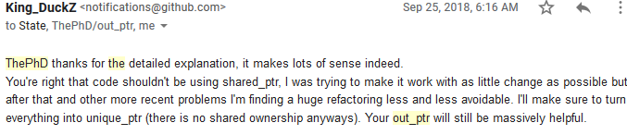
Implementation Experience
Lots of it
VMWare for a long time
My own code for a long time
Others for a long time: https://groups.google.com/a/isocpp.org/forum/#!topic/std-proposals/8MQhnL9rXBI
Public implementation: https://github.com/ThePhD/out_ptr
Already in use from others

Slide 14
Fun for the WEek
Polishing…
implementation; C++11 only
examples – simple and complex
Writing….
formal documentation
colloquial documentation
At: https://github.com/ThePhD/out_ptr/issues

Slide 15
Thank You!
For listening,
And for (eventual) contributions!
Find me at
the #include<c++> Discord, C++Now 2019 Channel (cppnow2019): https://discord.gg/ZPErMGW
the CppLang Slack, Library in a Week Channel (cppnow-liaw): https://cpplang.slack.com/archives/CAJQY2YBS/p1557203114009100

